Slide 1

Team Sideshow Bob
Members:
Евгени Костадинов
Иван Иванов
Радослав Стоянов
Станислав Стойчев
Страхил Нейков

Slide 2
Project: Car Dealership
Basic structure:
vehicles, clients, employees
Functionality:
Customize and create you own vehicle
Browse a selection of predefined
Vehicles
Test drive
Watch out for the crazy back-stabbing
dealer from Gorublyane!

Slide 3
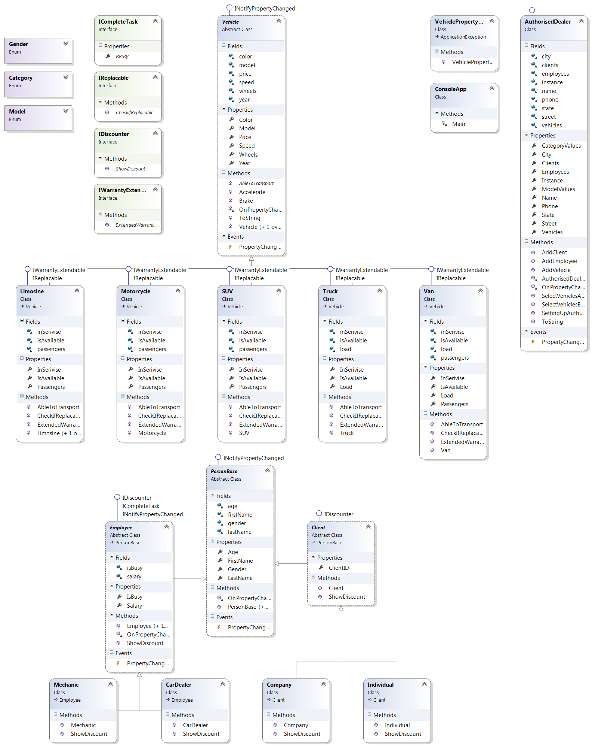
Class Diagram

Slide 4
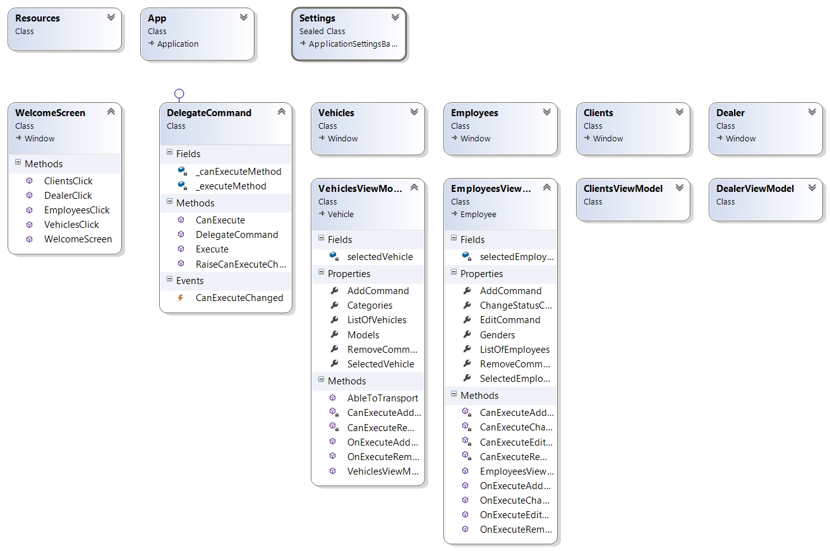
UI Demonstration
Thank you for your attention

Slide 5
Team Sideshow Bob
Thank you for your attention

